Slide 1
Automated Health Management System
Mario Uesaka
Jalal Mammadov

Slide 2
Project overview

Slide 3
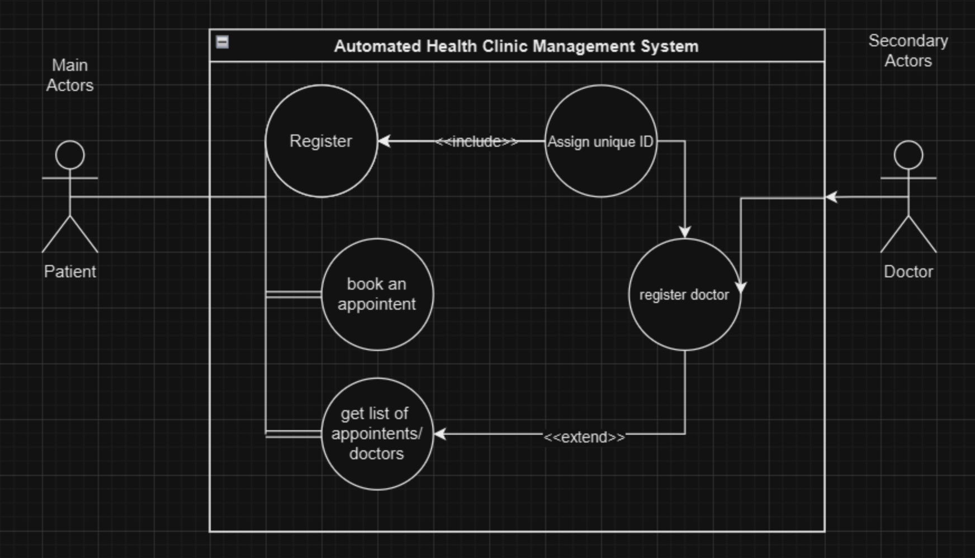
Use case Diagram

Slide 4
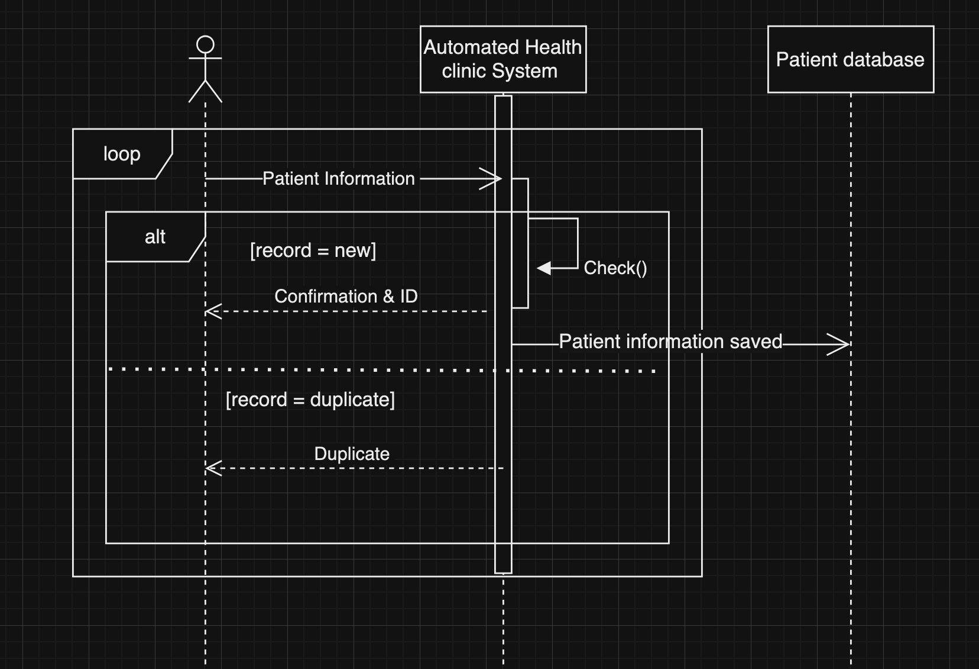
Sequence Diagram / Registration

Slide 5
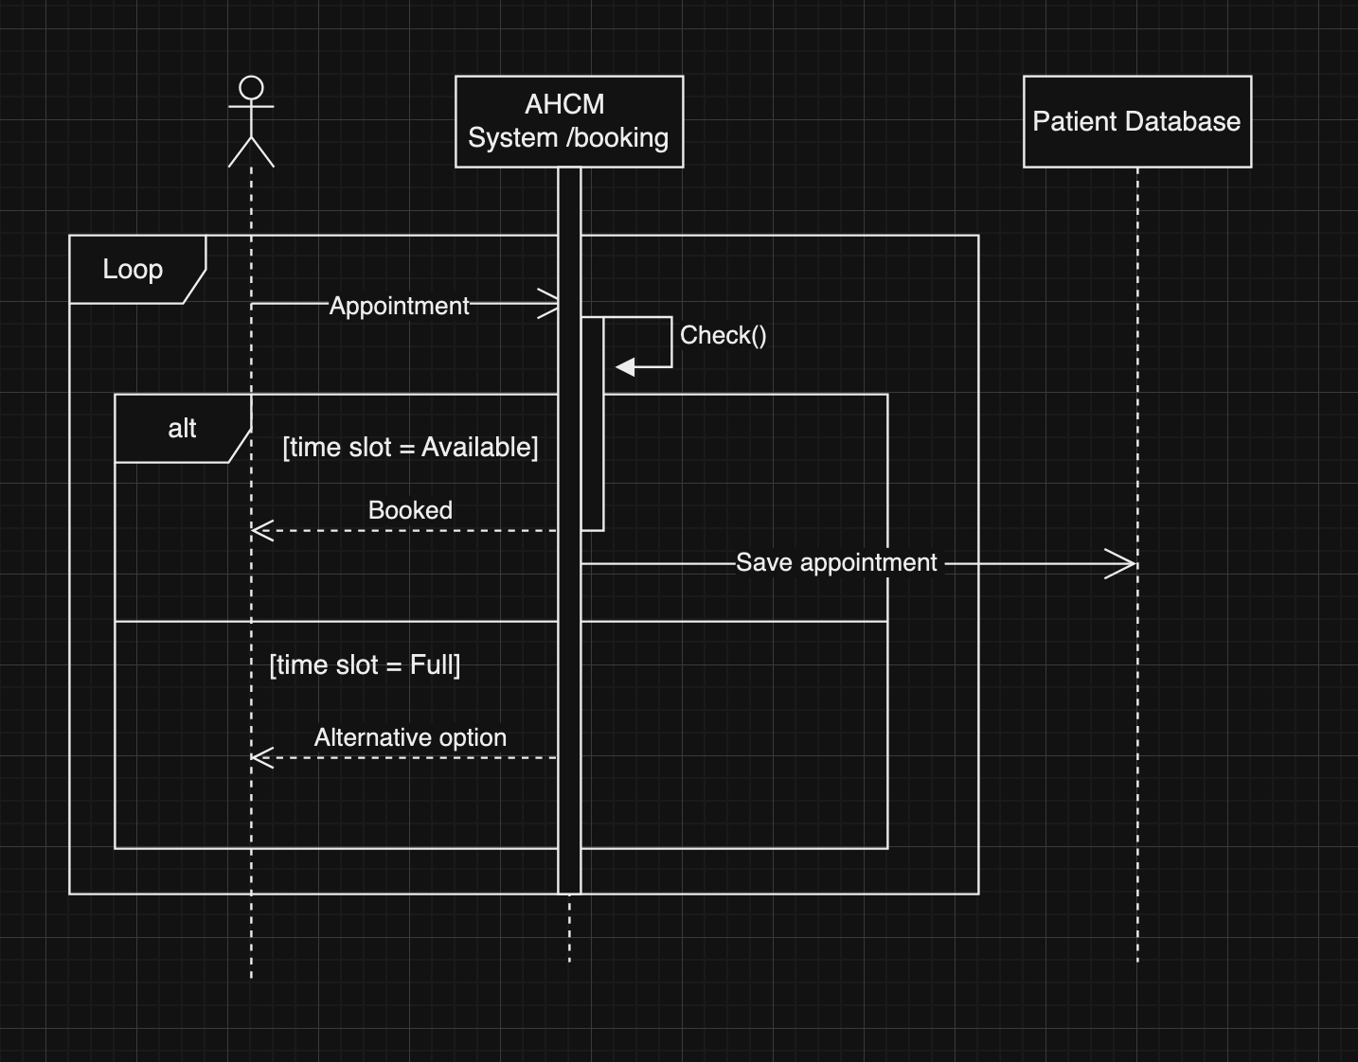
Sequence Diagram / Booking

Slide 6
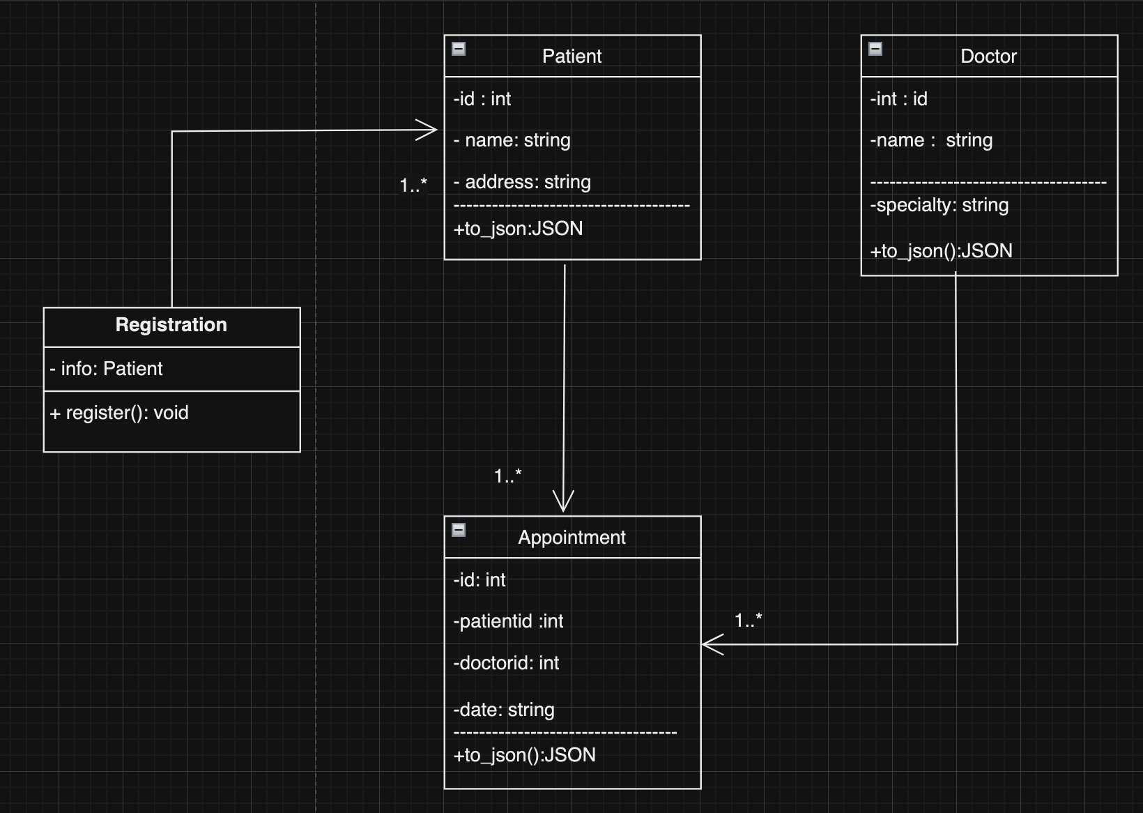
Class Diagram

Slide 7
System implementation

